Slide 1
Automation and Management with Catalyst Center APIs
Hector Morales
Global Partner Engineering
Marival Cruz
EMEA Partner Engineering

Slide 2
1
Introduction and lab objectives
2
Catalyst Center deep dive
3
Lab introduction
4
CatC APIs 100-200 level with Postman collections
5
CatC APIs 300-400 level using jupyter notebooks and python

Slide 3
Catalyst Center Headless Deployments

Slide 4
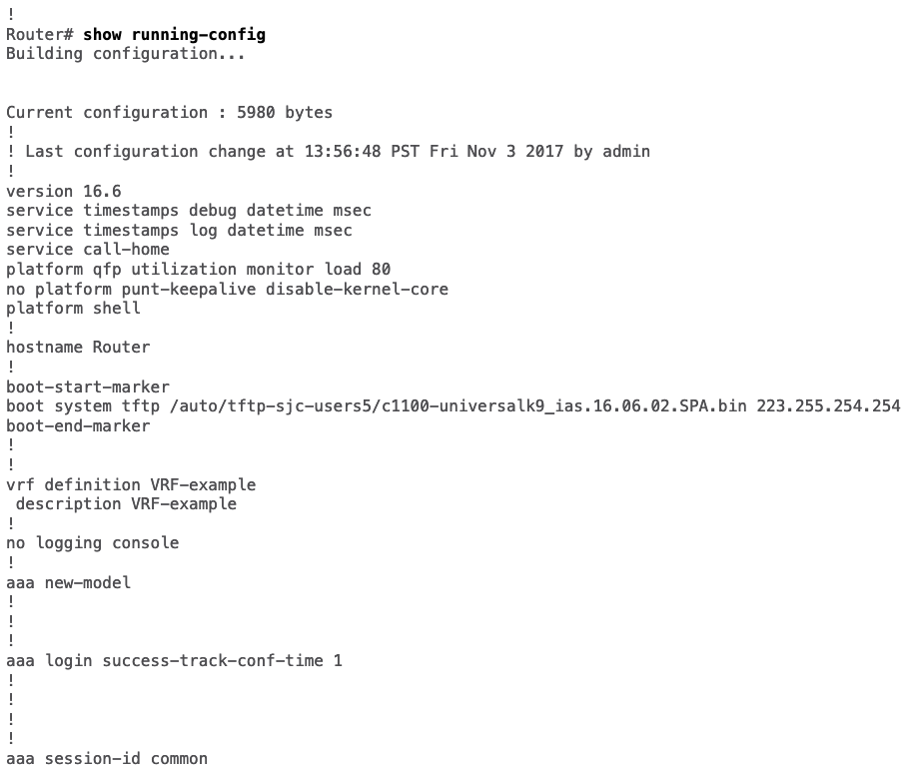
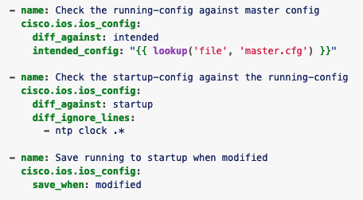
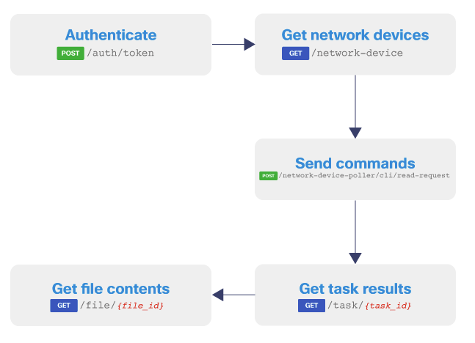
The complexity to operate large networks
IOS XE Ansible Collection
Cisco Catalyst Center APIs
IOS XE CLI

Slide 5
The complexity to operate large networks
Pros and Cons
IOS XE CLI
IOS XE Ansible Collection
Cisco Catalyst Center APIs
✔︎ ✔︎ ✔︎ ✔︎ ✔︎
✔︎ ✔︎ ✔︎ ✔︎ ✔︎
✔︎ ✔︎ ✔︎ ✔︎ ✔︎
Day 0
Fine configuration
Prone to human errors
IaC, CI/CD pipelines
Requires more expertise
API Platform
Single tenant
✔︎ ✔︎ ✔︎ ✔︎
✔︎ ✔︎ ✔︎
✔︎ ✔︎ ✔︎ ✔︎ ✔︎
Day 1
Data rich
Requires additional infra
Leverage community
Prone to errors
Extensive integration
Requires more coding
✔︎ ✔︎ ✔︎ ✔︎
✔︎ ✔︎
✔︎ ✔︎ ✔︎ ✔︎ ✔︎
Day 2
Information rich
Complex to troubleshoot
Leverage community
Not ready for Day 2
Event management
Requires more coding
Complexity ¹
Very complex
Mid complexity
Low complexity
IDEAL Team size ²
10-15 engineers
5-7 engineers
3-5 engineers
REALITY CHECK: We operate with reduced teams
Source: Own research with public data from top 100 customers and service providers, 2024
1 - Network size: 20,000 devices in a single campus
2 – Necessary team to support single campus

Slide 6







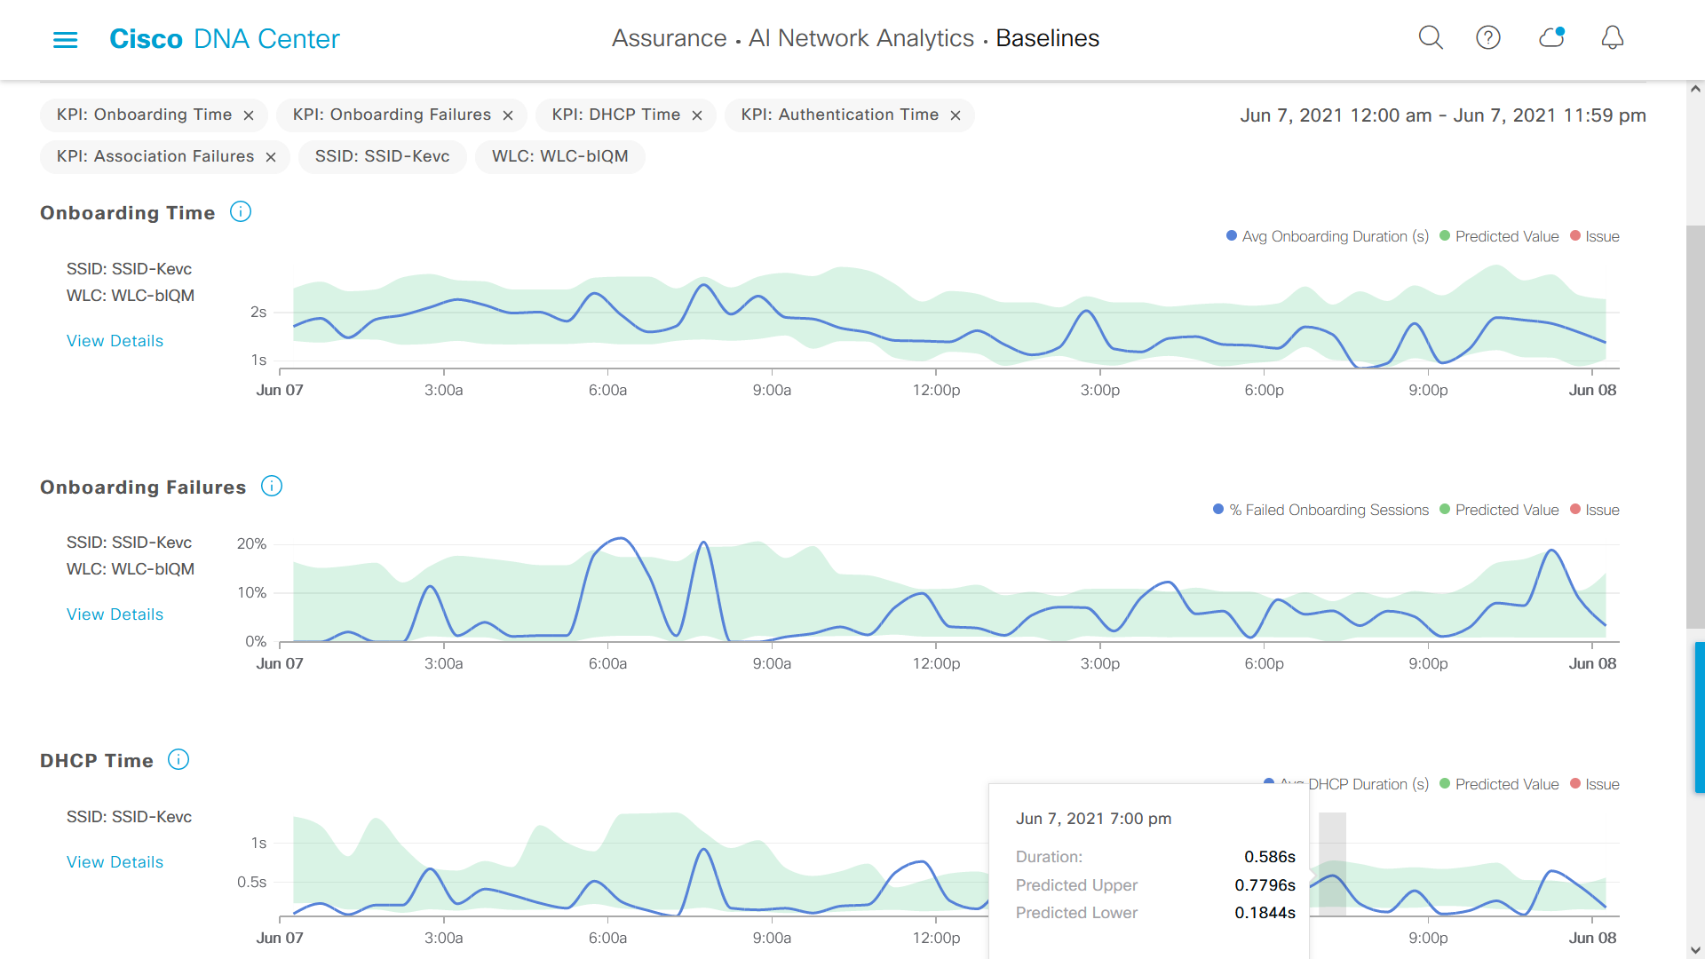





Catalyst Center simplifies network operations
Enabling IT admin to deliver business outcomes, smarter and faster at scale
Small teams’ productivity increase through automation
Visibility
Automation
Increase Scale
Observability
Zero Trust
NetOps
Providing customers with business resiliency, continuity, and quick time to value
Enabling customers to achieve Compliance of network with config policies
Automation to simplify the creation and maintenance of customers networks
Insights
Programmability
Improved Security
Cisco Catalyst Center
SecOps
AI-driven security to classify endpoints and enforce security policies for a complete zero trust workplace solution
Automate end point visibility, classification, and grouping​
Improved Service Delivery
DevOps
Mature APIs, SDKs, and closed-loop integrations to simplify and streamline ecosystem integration
Faster service delivery using API-based automation workflows
Early issue detection and integration with 3rd party platforms through enhanced notification channels
Physical and virtual infrastructure
Improved Performance Insights
AIOps
Reduced proactive problem resolution through faster Root Cause Analysis
AI-driven visibility, observability, insights, and troubleshooting to ensure the health your customers applications, infrastructure and user experience

Slide 7

Catalyst Center as a platform
Powered for headless integration
Event Notifications
Northbound REST APIs
Assurance Issues
AI/ML Insights
System Health
Integration Connectivity
License Management
Webhooks
PagerDuty
Email
Syslog
SNMP
Network Inventory
Network Topology
Network Design
Provisioning
SWIM, PnP
Path Trace
Assurance
SDA
Templates
RMA
Config Archive
Sensors
IT Ecosystem Integrations
Developer Resources
IT Service Management
IP Address Management
Reporting
Wireless Planning
Alerting
SIEM
Sample Code, Videos
Python SDK, Ansible, Terraform
Cisco DevNet
Sandboxes, Learning Labs
Developer Guides
Sample Code
Notes:
Intent of this slide is to outline the feature benefits of DNAC –
Ease of integrations -

Slide 8






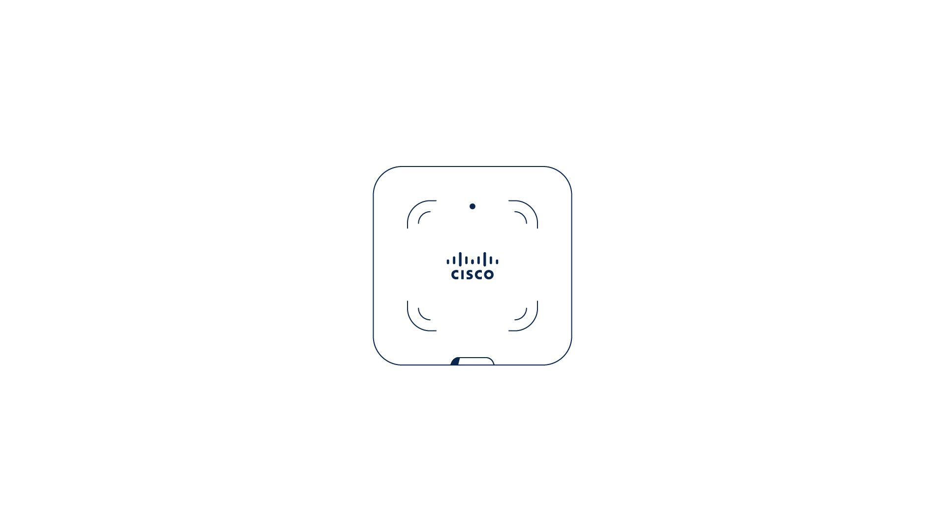
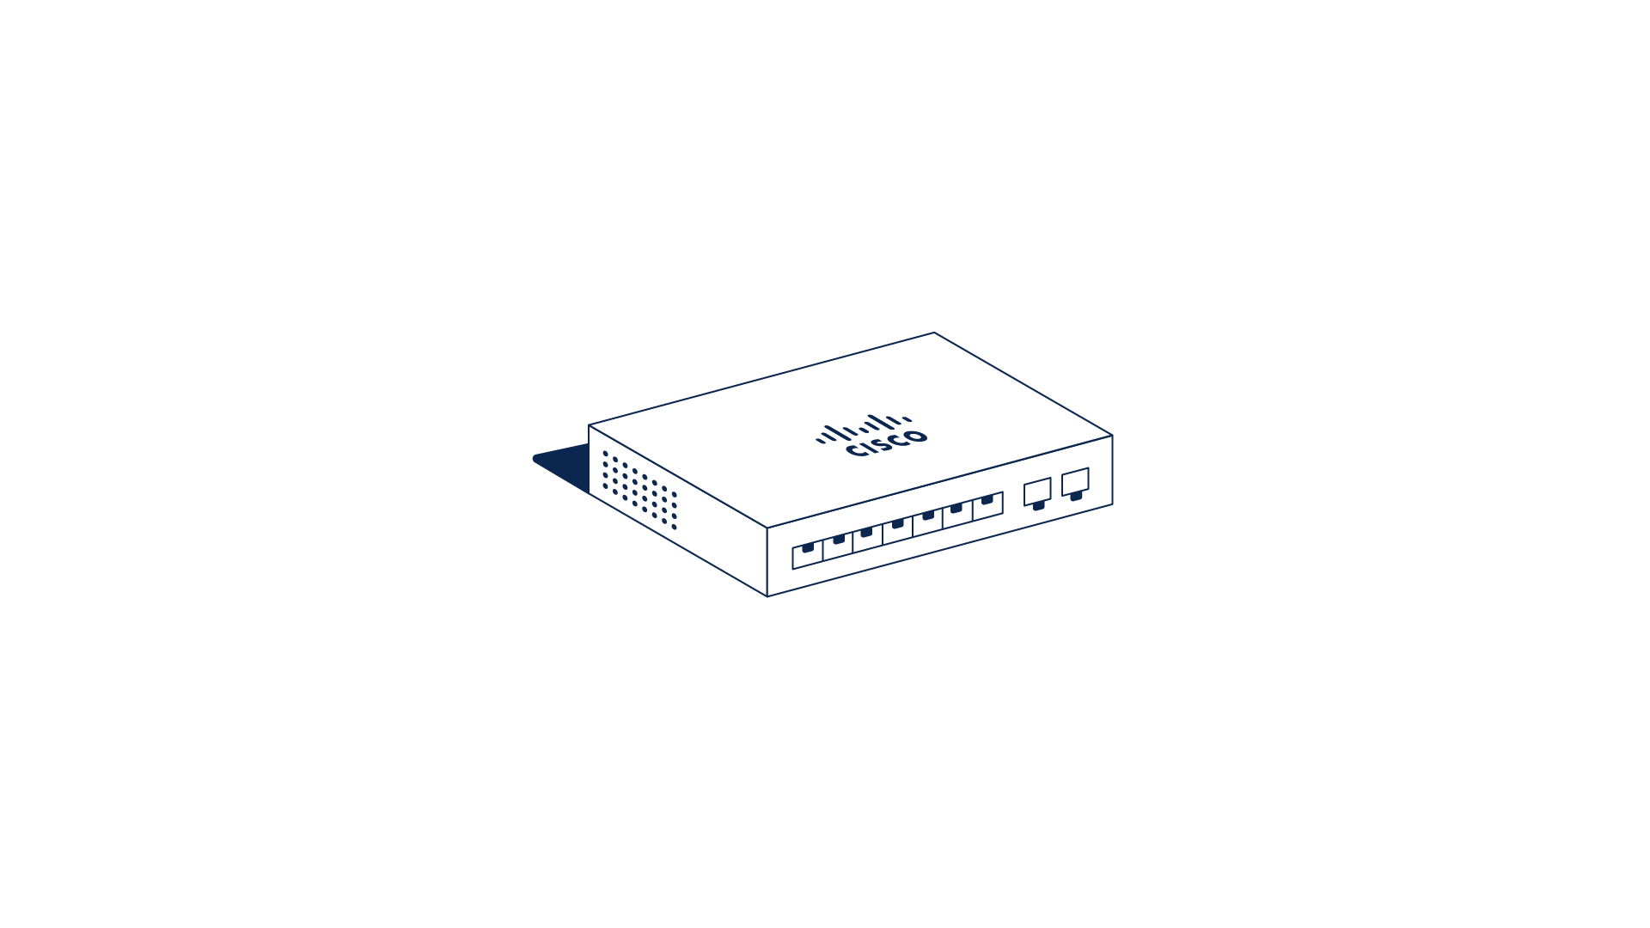


Cisco Catalyst Center enterprise architecture
Align to ITIL framework
Tools
Enterprise Application-specific tools for reporting, incidents and trouble tickets
Intent API
ServiceNow
Splunk
PagerDuty
Webex
Enterprise IT Service Management
Integration API
Events and Notifications API
Enterprise Event Management and Notifications
Cisco Catalyst Center
Enterprise Network

Slide 9



Cisco Catalyst Center architecture
Headless operations: operate Catalyst Center at scale
OSS/BSS stack – home-grown or vendor-based
Dashboard and Tools
Incident management and trouble shooting
Operations Dashboard
Intent API
ServiceNow
Splunk
PagerDuty
Webex
Integration API
Events and Notifications API
Cisco Catalyst Center
Cisco Catalyst Center
…
Cisco Catalyst Center
Enterprise IT Service Management
Enterprise Event Management and Notifications

Slide 10

A high-level view
Catalyst Center headless deployment example
OSS/BSS stack
Monitor
AIOps
Reduced staff
Insights
Intent API
Events and notifications API
Integration API
Webhook
Cisco Catalyst Center
Splunk
Webex
ServiceNow
Switching
Routing
Wireless
SDA
Notes:
This is NOT an architecture, but a recommendation based on a few customer and partner experience/deployments

Slide 11
Catalyst Center APIs

Slide 12

What a headless scenario looks like
Network Operations
People, Processes, Run books and System integration
A
B
Cisco Catalyst Center
Cisco Catalyst Center
Operations Segmentation Layer
OSS/BSS
Regional operations dashboard
API
C
Cisco Catalyst Center

Slide 13
Cisco Catalyst Center API platform
Event and Notifications API
Intent API
Integration API
Provides a notification handler when specific events are triggered, such as Network Assurance and Automation (SWIM) events.
Enables external systems to take actions in response to an event: execute a software upgrade action in response to an out of compliance notification of network devices
Notifications may also be triggered by internal Catalyst Center events. For example, Assurance events can be customised for IT Service Management incidents.
The Intent API is a REST API that exposes specific capabilities of the Cisco Catalyst Center platform.
Provides policy-based abstraction of business intent, allowing focus on an outcome rather than struggling with individual mechanisms steps.
The RESTful Cisco Catalyst Center Intent API uses HTTPS verbs (GET, POST, PUT, and DELETE) with JSON structures to discover and control the network.
Provides mechanisms for integrating Network Assurance end-to-end workflows and data with third-party IT Service Management (ITSM) solutions.
ITSM integration minimises handoffs, reduces duplication of issues, and optimizes processes such as approval- and pre-approval chains,
Cisco Catalyst Center also Integrates with Reporting and Analytics capabilities for capacity planning, asset management, compliance control, and auditing.

Slide 14
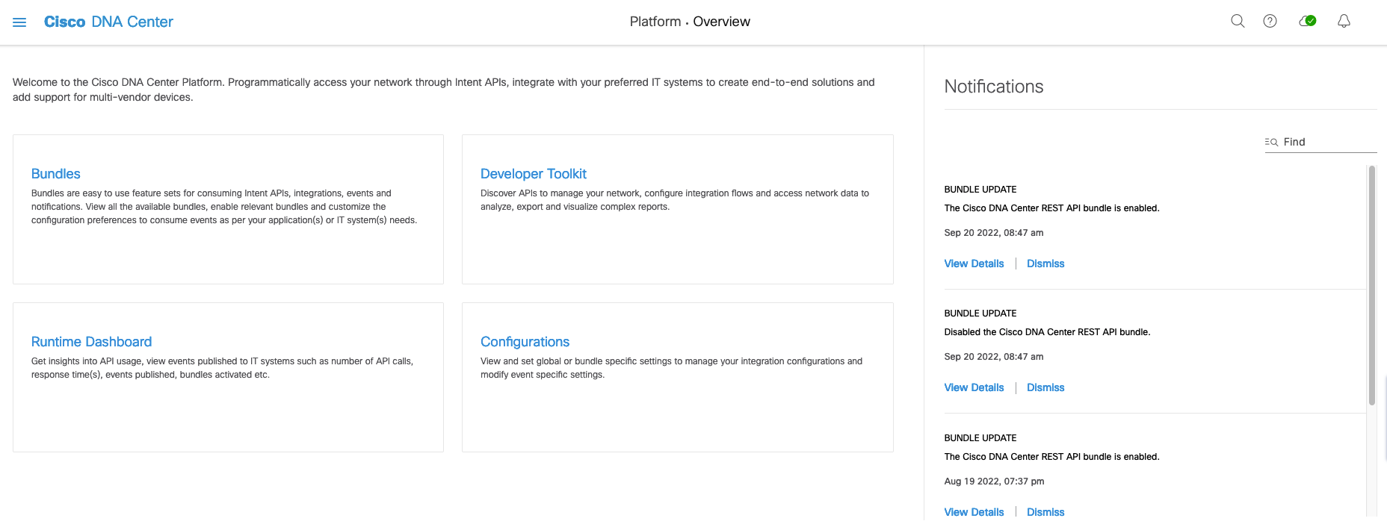
Cisco Catalyst Center
Platform overview

Slide 15
Options for CatC Labs
DevNet Catalyst Center Sandboxes:
https://developer.cisco.com/docs/dna-center/sandboxes/#cisco-catalyst-center-sandbox
dCloud
Cisco Enterprise Networks Hardware Sandbox v4.1 (This lab)

Slide 16
CatC API documentation
In CatC in the Platform overview
In DevNet
https://developer.cisco.com/docs/dna-center/cisco-dna-center-2-3-7-api-overview/

Slide 17
CatC API way to consume
Postman collections (the easiest)
Programming languages:
Python (the most popular)
Ansible
Catalyst Center SDKs
Prebuild libraries for REST API Calls
Offers all methods and error handling
https://dnacentersdk.readthedocs.io/en/latest/
https://github.com/cisco-en-programmability/dnacentersdk

Slide 18
Lab introduction

Slide 19




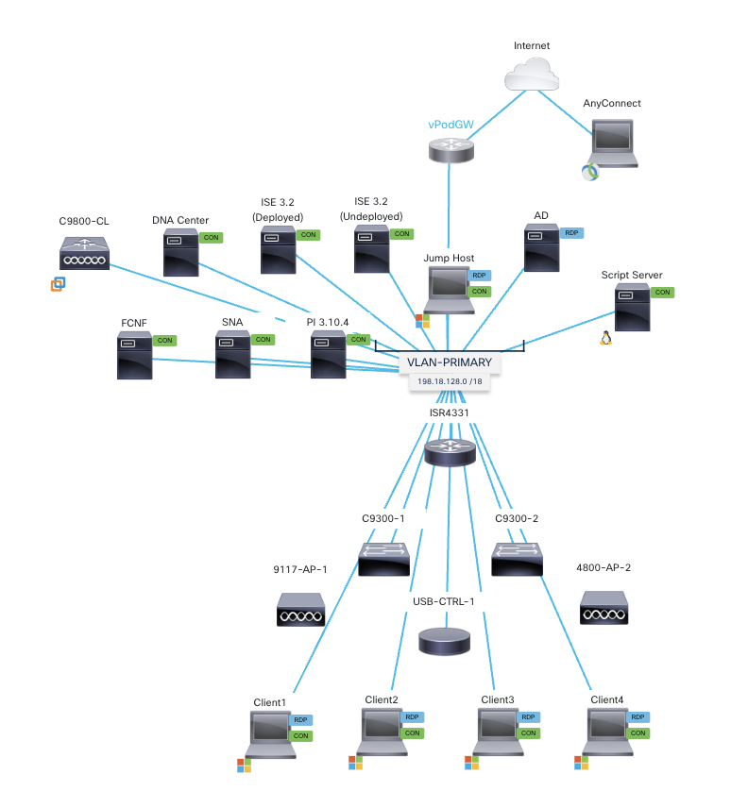
Lab description
Prerequisites
Jump windows host
Internet
Laptop with Cisco Anyconnect client
User preferable with Postman account
Sandbox

Slide 20
Cisco Enterprise Networks Sandbox v4.1
Jump host and servers including CatC

Slide 21
Cisco Enterprise Networks Sandbox v4.1
Network devices and clients

Slide 22
What is in this environment?
Virtual Machines
DNA Center 2.3.5.5
Identity Services Engine (ISE) 3.2 Patch 5 – (Deployed)
Identity Services Engine (ISE) 3.2 – (Undeployed)
Secure Network Analytics (Stealthwatch) 7.4.2
FlowCollector 7.4.2
Cisco Prime Infrastructure 3.10.4
Wireless LAN Controllers – C9800 running IOS-XE 17.12.3 code
Windows 10 Jump Host – Contains links to common URLs needed to view and configure the environment. Can also be used to TFTP files to/from the hardware devices. Can be used to pull files from Box.
Ubuntu 20.04.3 – Can be used as a script server and for programing tools.
Windows Server 2019 – Can be configured to provide identity, DHCP, DNS, etc.
Windows 10 Clients – Used to simulate network clients participating in the environment. Can be used to test segmentation, host onboarding, policy implementation, etc.

Slide 23
What is in this environment?
Hardware devices
ISR 4331 Router - 17.09.02a IOS-XE Code
Catalyst 9300 Switches - 17.09.02 IOS-XE Code with Embedded Wireless Controller (EWC) and ThousandEyes Enterprise Agent
9117 Access Point
4800 Access Points
Silex Controllers (2 Wired NICs)

Slide 24
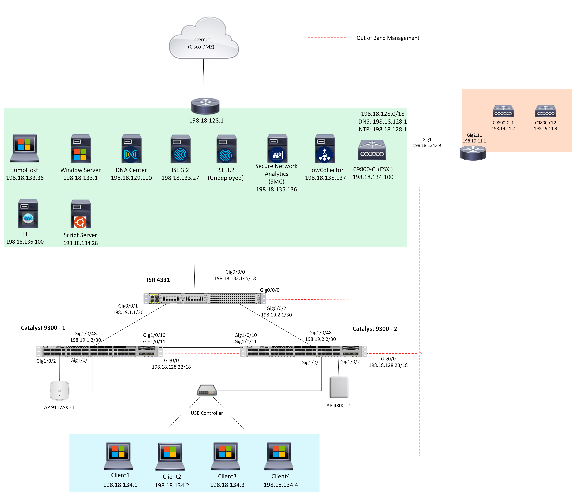
Topology

Slide 25
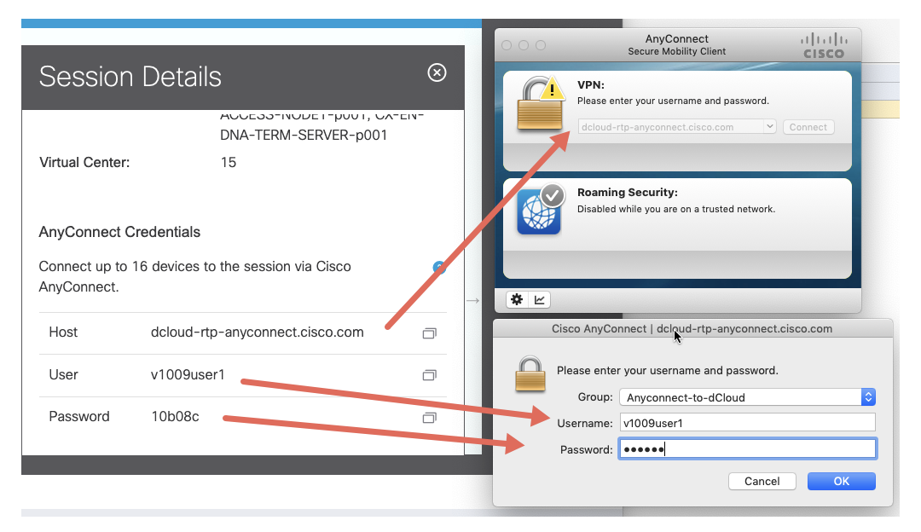
How to access your environment?
Connect to the demo with Cisco AnyConnect VPN. Find your AnyConnect information in the Session Details for your dCloud session.
Use your local browser to connect to URLs as outlined in the table in the Virtual Machines section that follows.
Use your local RDP client to connect to RDP-capable Virtual Machines as outlined in Virtual Machines section that follows.

Slide 26
Virtual Machine Addressing and Credentials
IP Address | Name | Username | Password | Preferred Access Method
Entry | ISE 3.0 Undeployed | Entry | Entry | ​VM Console via dCloud UI​​Chrome or Firefox (once configured)​
198.18.133.27 | ISE 3.0 (Deployed) | admin | C1sco12345 | Chrome or Firefox
198.18.129.100 | DNA Center | admin | C1sco12345 | Chrome or Firefox
198.18.135.136 | Secure Network Analytics (Stealthwatch) | admin | C1sco12345 | Chrome or Firefox
198.18.135.137 | FlowCollector | admin | C1sco12345 | Chrome or Firefox
198.19.11.2 | C9800-CL1 | admin | C1sco12345 | ​Chrome or Firefox​​SSH or Telnet​
198.19.11.3 | C9800-CL2 | admin | C1sco12345 | ​Chrome or Firefox​​SSH or Telnet​
198.18.134.49 | ESXi-Router | admin | C1sco12345 | SSH or Telnet​
198.18.136.100 | Cisco Prime Infrastructure | admin | C1sco12345 | Chrome or Firefox
198.18.134.28 | Script Server | root | C1sco12345 | ​Chrome or Firefox​​SSH​
198.18.133.36 | Jump Host | admin | C1sco12345 | RDP
198.18.133.1 | AD | admin | C1sco12345 | RDP
198.18.134.1 | Client1 | admin | C1sco12345 | RDP
198.18.134.2 | Client2 | admin | C1sco12345 | RDP
198.18.134.3 | Client3 | admin | C1sco12345 | RDP
198.18.134.4 | Client4 | admin | C1sco12345 | RDP

Slide 27
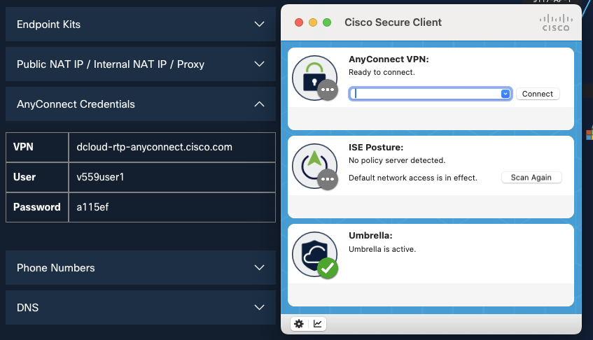
Cisco Secure Client

Slide 28
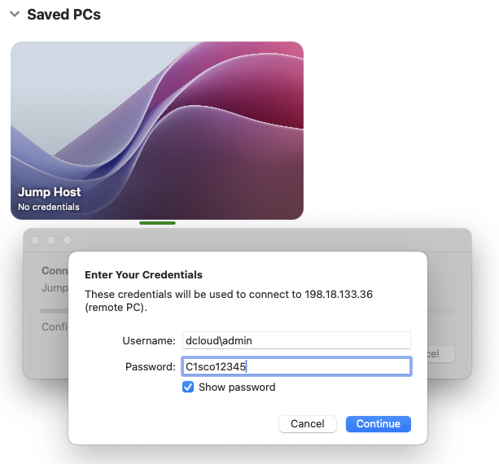
RDC to jump host
Jump windows host
Cisco Catalyst Center

Slide 29

Windows Jump Host

